Slide 1

Week 4 – The Battle of Neighborhood
Kelly Fong – 27 July 2021

Slide 2
Business Problem
An entrepreneur is interested to invest in starting up a stall in Scarborough,Toronto premises. He has yet to decide on the type of stall he is opening, and the exact location/neighbourhood to set up. Hence, he will be doing an analysis to determine the most well-received stall category as well as the most popular neighbourhood in Scarborough, Toronto.

Slide 3
Description of Data
Given that we are interested to explore the neighbourhood of Scarborough Toronto as well as the venues around that neighbourhood, we will require the list of location/neighbourhood around Scarborough, Toronto. In addition, we would also require the information of the stalls, broken by category around that neighbourhood alongside with the data tagged to the stalls.
With this, we will be scraping the postal codes of Scarborough, Toronoto through the Wikipedia website ( https://en.wikipedia.org/wiki/List_of_postal_codes_of_Canada:_M). Followed by using the Foursquare data to retrieve the venues in the respective neighbourhoods and to conduct analysis on which stall category is the most popular and in which neighbourhood.

Slide 4
Overview of Methodology
The methodology include the following:
1. Importing all the necessary libraries
2. Web scrap all the neighbourhood data of Scarborough Toronto from the Wikipedia webpage.
3. Transform the data scraped from step 2 to a dataframe.
4. Perform data cleaning to the dataframe to remove any NULL values.
5. To retrieve the longitude and latitude for the respective neighbourhood.
6. Using the foursquare API data to retrieve all the corresponding nearby venues located near the neighbourhood.
7. Merge both dataframe into one.
8. Compute the popularity of the stalls by neighbourhood and venue category.

Slide 5
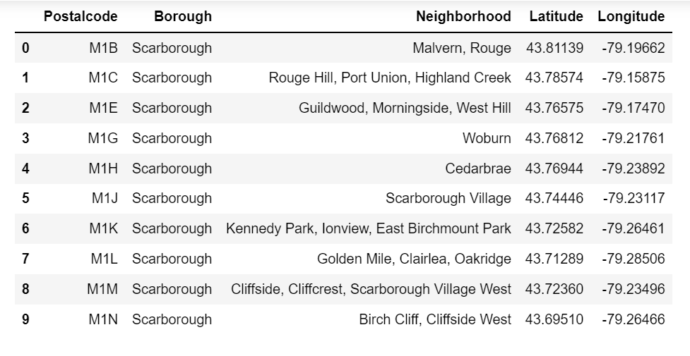
The Neighbourhood Data
A snapshot of the Scarborough Toronto neighbourhood data.

Slide 6
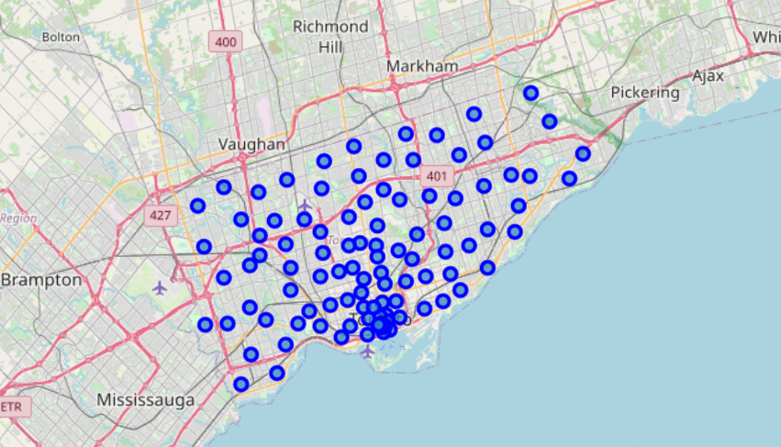
Visualisation of the Neighbourhood
Using the Folium package, I’ve created the visual plot to see where are all the neighbourhood located in Toronto.

Slide 7
Methodology
With the neighbourhood data, we would now require the list of venues , and the venue categories located around the list of neighbourhood. To do so, we would need to call on Foursquare API to extract the relevant data.
Data Extraction

Slide 8
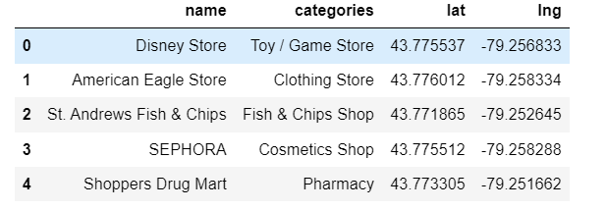
Foursquare API Data (venues)
A snapshot of the list of venue, its categories as well as the geospatial information.

Slide 9
Methodology
Now that we’ve got 2 dataframes (the neighbourhood dataframe and the venue dataframe), we could now merge the data, perform one-hot-encoding on the categorical variable and derive the frequency of these venue in the respective neighbourhood.
Data Transformation

Slide 10
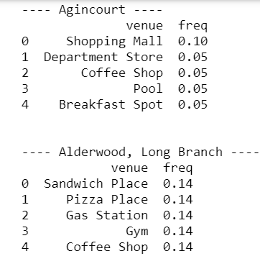
Analysis on the venue in the respective neighbourhood
A snapshot on the frequency count of each venue in the respective neighbourhood.

Slide 11
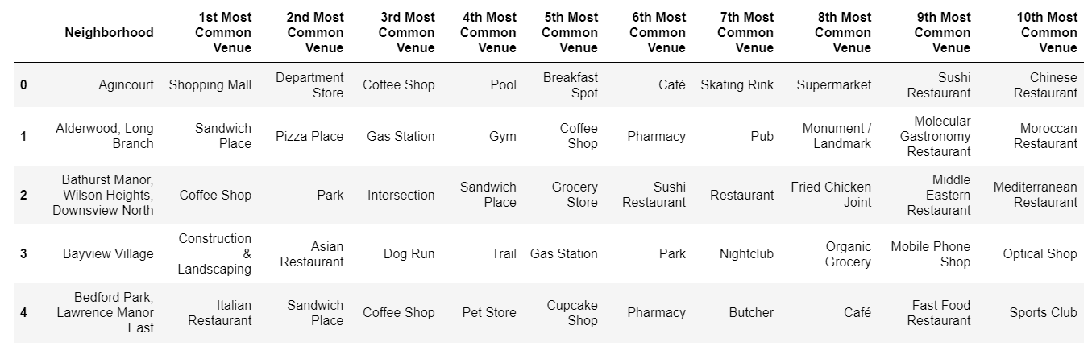
Analysis on the venue in the respective neighbourhood
With the frequency, we can now derive the top 10 most visited venue by its neighbourhood. A snapshot of the dataframe showing the most commonly visited venue by neighbourhoods.

Slide 12
Analysis
Based on the data, we derived that the entrepreneur should open a coffee shop in the neighborhood of Scarborough Toronto.
Recommendation based on the insights derived

Slide 13
THANK YOU
KELLY FONG

